Slide 1
PeopleBrowsr TV Analytics
Strata Summit 2011
Jodee Rich
CEO PeopleBrowsr

Slide 2

Social TV Analytics will eventually replace Nielsen as the primary data used by Media Buyers….
Here’s Why…

Slide 3
Objectives
Replace Nielsen rating system with Social Media Data
Identify TV Show preferences of the Social Audience
Implement traditional ratings with Social Data to achieve more accurate results

Slide 4
The Test Case
Filter Social mentions of 900 major TV Shows in the United States
Communities Composed of Social Media Users related by their Affinities

Slide 5
The Challenge
Refine millions of searches to identify content relevant
to TV Shows
Create comprehensive filters to classify Communities based on demographic data

Slide 6

The Solution
TV Show Identification
Search beyond exact Show Titles
    AKAs
    Typos
    Characters Names
    Actors Names
House OR Gregory House OR GregoryHouse OR Doctor House OR DoctorHouse OR DrHouse OR Dr House OR Doctor Cuddy OR DoctorCuddy OR DrCuddy OR Lisa Cuddy OR Hugh Laurie OR ….

Slide 7
The Solution
TV Show Identification
Filter out noise and irrelevant results
    Contextual
    Proximity
    Exclusions
NOT the house OR my house OR your house OR *s house OR this house OR that house OR cleaning OR for sale OR buying OR sold OR bought OR dog house OR our house OR full house OR fire OR leave OR party OR white OR …

Slide 8
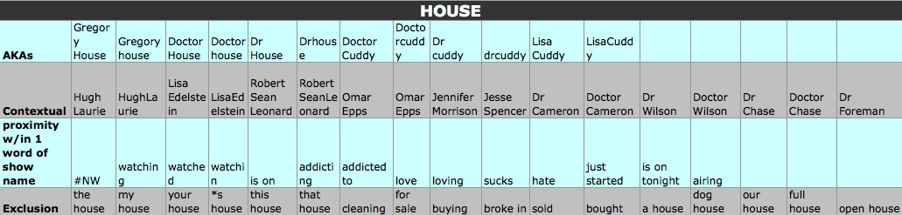
The Solution
TV Show Identification
Example: House

Slide 9
The Solution
Communities
Identify demographics through
    Declared Age
    Marital Status
    Profession
    Followers of account
Under18 = (student OR freshman OR junior OR senior) AND (list of 18K high schools) OR in high school OR I’m 6-17 years old OR I’m a teenager OR student of (high schools) OR studying for the ACTs OR learning to drive OR I want a fake ID OR …

Slide 10
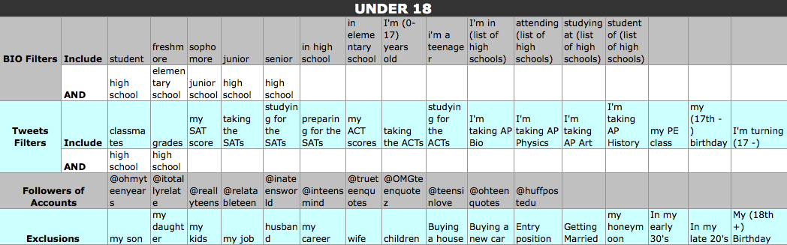
The Solution
Communities
Example: Under 18 Users

Slide 11
Data Size
Total number of TV Show mentions since January 2011
30 Million

Slide 12
Data Size
Number of people in each Community
Under 18 – 1,615,107
Age 19-24 – 412,479
Age 25-35 – 1,636,156
Moms – 370,762
Heavy Searchers U. 18 – 132,231
Heavy Searchers 19-24 – 40,980
Heavy Searchers 25-35 – 201,238
100K – 346,537
Allergy – 134,585
Tech – 5,111,413
Adventure + Tech – 1,673,600
Active Investors – 5,127
Adventurers/Outdoors – 139,121

Slide 13
Data Size
Number of people in each Community
Community | # Observed |  | Community | # Observed
Under 17 | 1,615,107 |  | $100k+ HHI | 346.537
19-24 | 412.479 |  | Allergy sufferers | 134.585
25-35 | 1,636,156 |  | Tech | 5,111,413
Moms | 370,762 |  | Adventure + Tech | 1,673,600
Heavy Searcher u. 18 | 132,231 |  | Active Investors | 5,127
Heavy Searchers 19-24 | 40,980 |  | Outdoor Adventurers | 139,121
Heavy Searchers 25-35 | 201,238

Slide 14
Data Flow - Communities
Firehose
RabbitMQ
Xapian
Search Indexer
Search Engine
Communitiser
Text File

Slide 15
Data Flow – TV Shows
Firehose
RabbitMQ
Xapian
Search Indexer
Search Engine
CloudWash
MySQL

Slide 16
Data Flow – Mentions/Links
Firehose
RabbitMQ
Xapian
Search Indexer
Mentioniser
MySQL

Slide 17
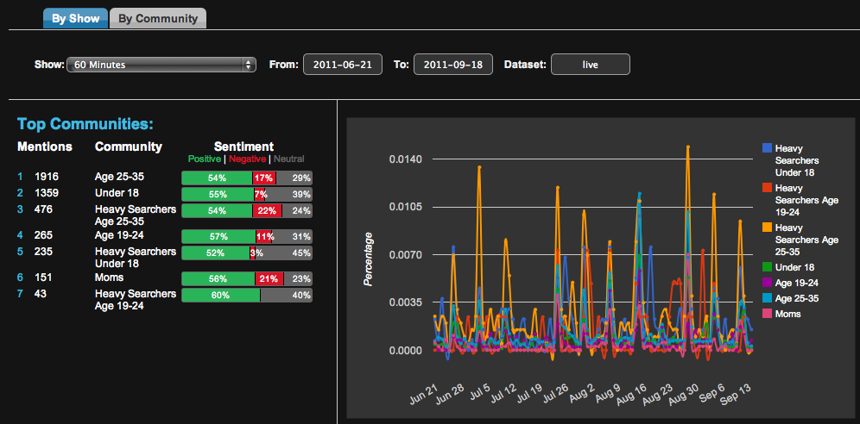
TV Shows Analytics
TV Show: 60 Minutes

Slide 18
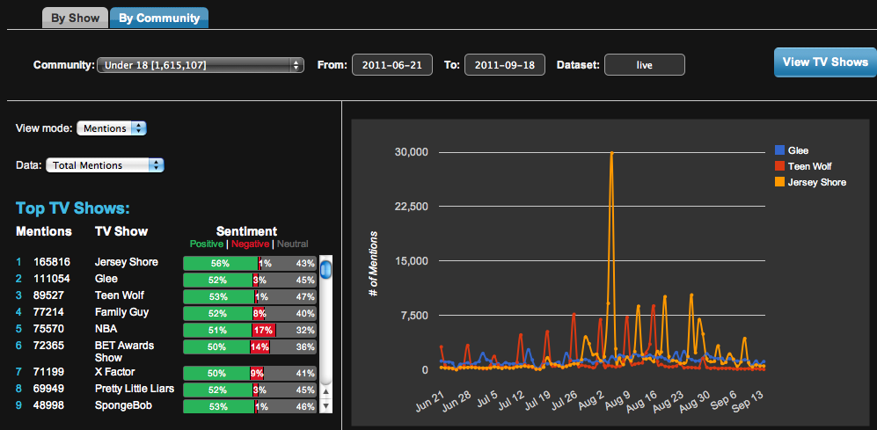
TV Shows Analytics
Communities: Under 18

Slide 19
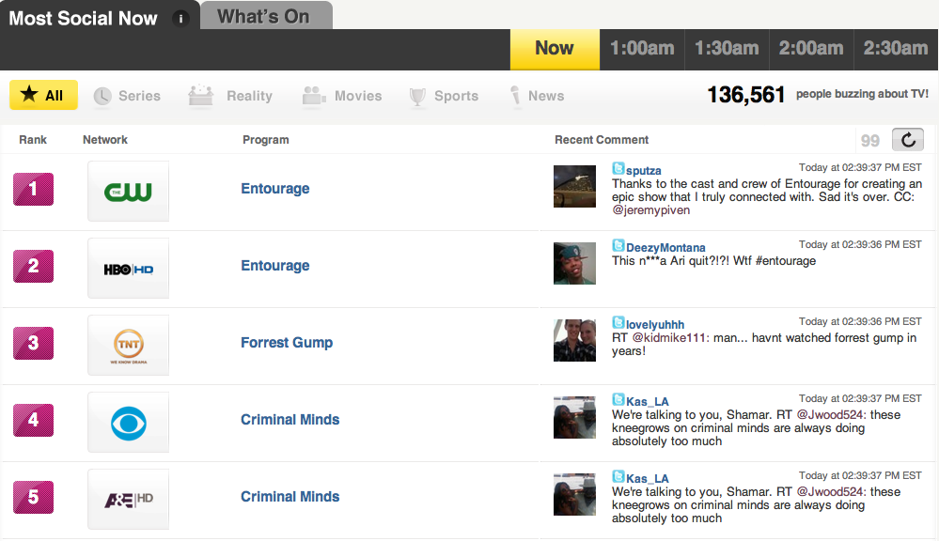
Examples of Consumer Apps
Social Guide
http://www.socialguide.com/

Slide 20
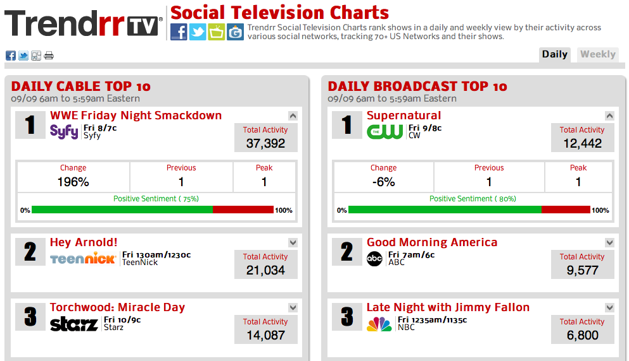
Examples of Consumer Apps
Trendrr TV
http://trendrr.tv/

Slide 21
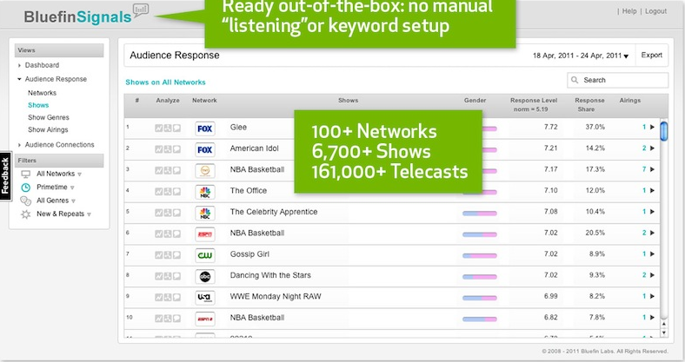
Examples of Consumer Apps
Bluefin Labs
http://bluefinlabs.com/

Slide 22

Kred
Influence and Outreach
Transparent Activity Statement
Community Based
Group Kred
Outreach Meter
Fresh Content
Advisory Function
Detailed Analysis

Slide 23

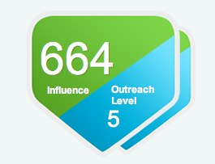
What is Kred?
Kred is measurable Influence
Kred offers separate metrics for Influence and Outreach.
Influence measures a user’s relative ability to inspire action from others like retweeting, replies or new follows.
Outreach measures generosity and rewards actions like interaction with others and willingness to spread the message.

Slide 24
Kred Influence
Influence is the measure of what others do for you
It is reported to on a normalized 1,000 point scale.
Influence is measured by
  Retweets
  @replies
  New follows
  List following
  Follow/following ratio
Influence is outbound – how you inspire others to take action.

Slide 25
Kred Outreach
Outreach is the measure of generosity
Outreach points are based in levels and will increase infinitely as users interact and spread messages from others.
Outreach is measured by
  Retweets
  @replies
  New follows
  List following
Outreach represents how others inspire you to interact and engage.

Slide 26
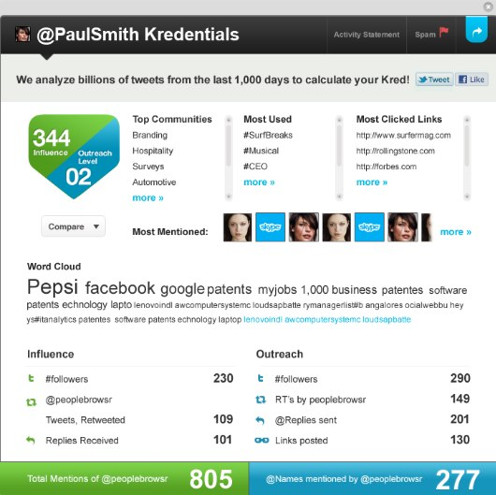
Kredentials for every @name

Slide 27

Swinging through the trees…Language evolved
Little Brother will carry the next level of Human Evolution – Influencers and Authorities independent of Institutions
@WingDude
JodeeRich@PeopleBrowsr.com

Slide 28
@WingDude
jodeerich@peoplebrowsr.com
http://slidesha.re/PBStrata

